Slide 1

Worksy Technical Seminar
Technology overview

Slide 2
FRONTEND

Slide 3
What is Tailwind?
Tailwind is a utility-first CSS framework to build customize user interface
Allow us to write inline styling which then transformed into corresponding style and written to a CSS file

Slide 4
Benefits of using Tailwind CSS
Unlike other CSS frameworks, where they provide prebuilt standard components, and we customize it. This result in very similar styles. Tailwind provides greater flexibility and control over how components appear and feel which create more unique looking UI.
Reduce the development time by using its abundance predefined classes
Optimization for unused CSS (PurgeCSS)
Notes:
https://www.swyx.io/why-tailwind

Slide 5
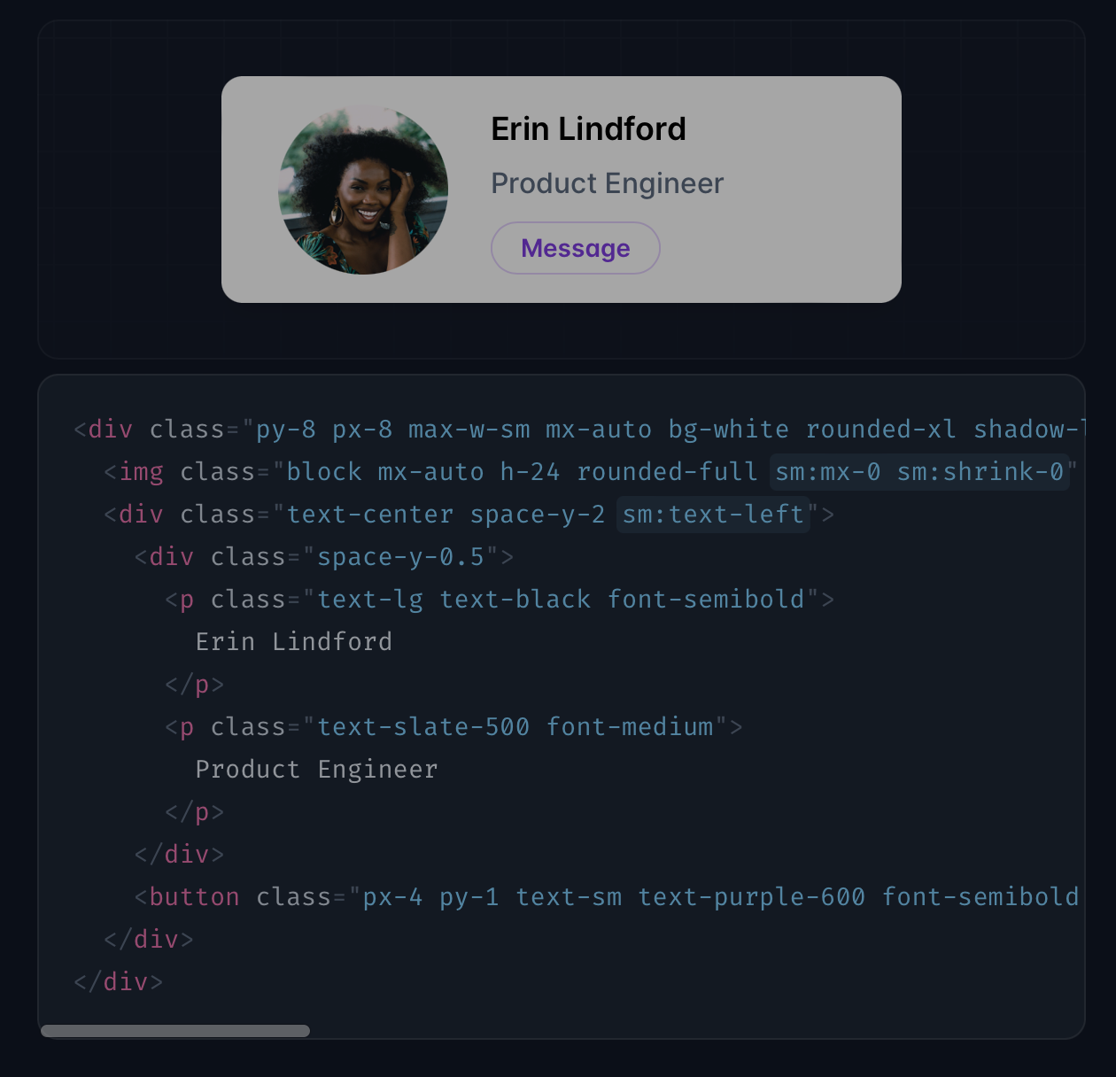
Quick view of Tailwind

Slide 6
Code duplication
Extract them into component to reuse

Slide 7
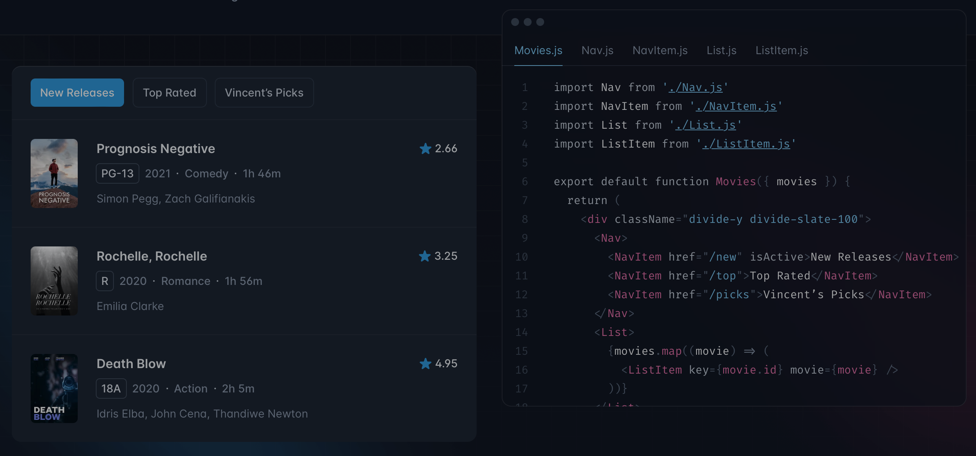

Slide 8
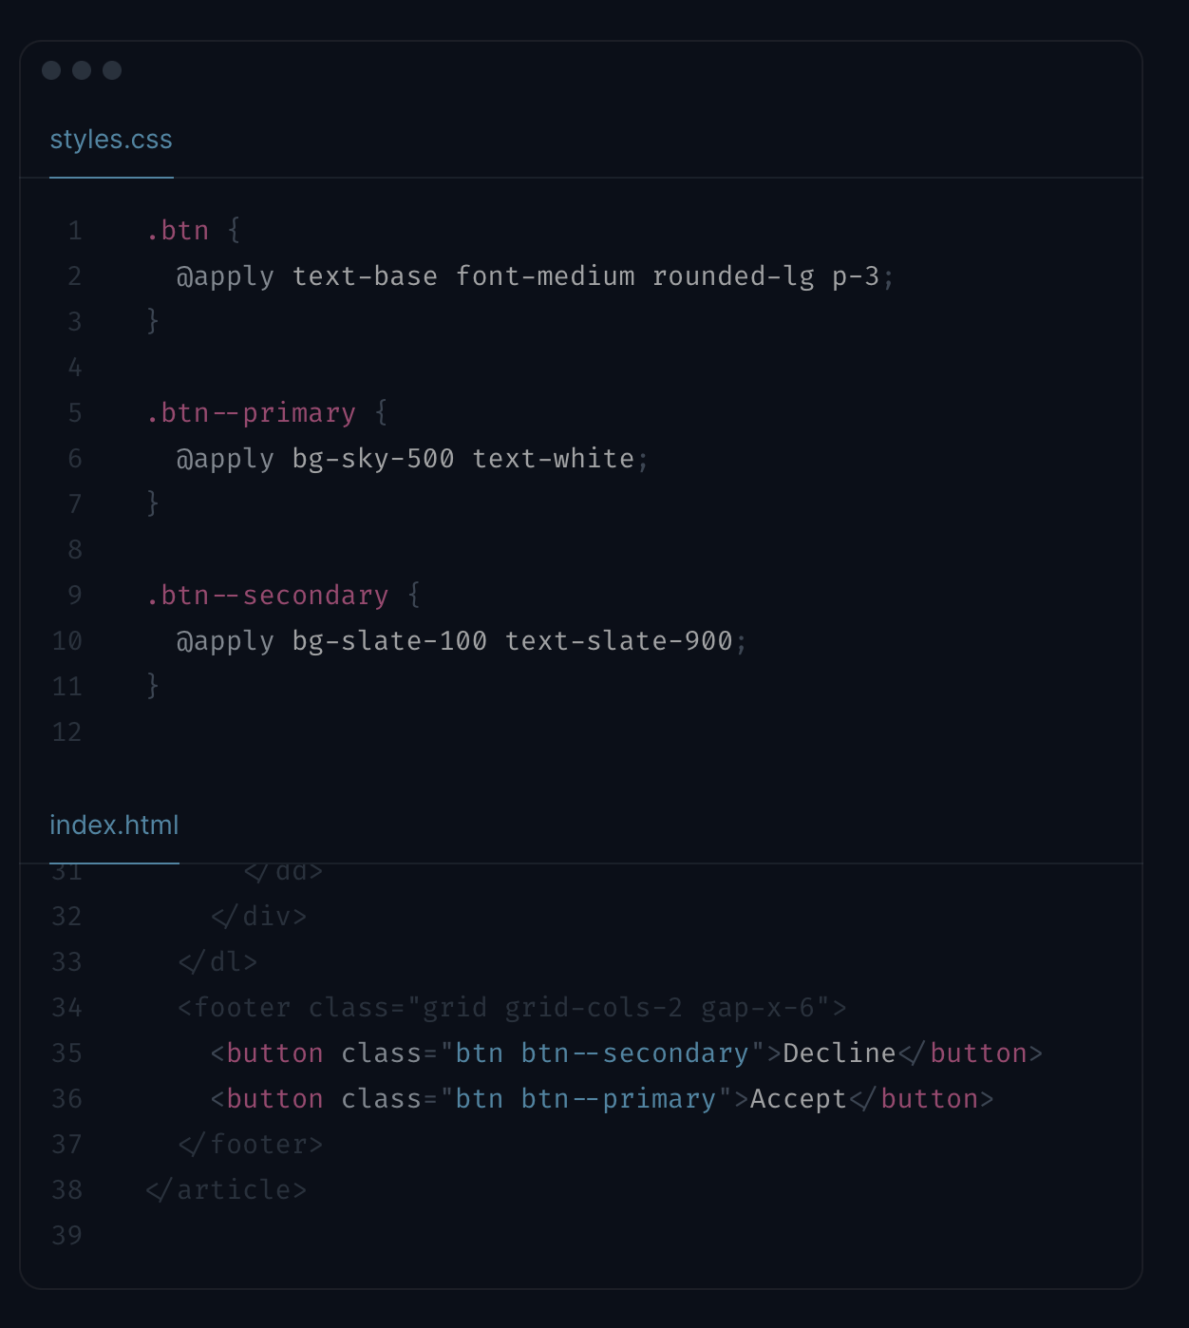
For people who don’t want to use component framework
Use @apply directive to extract into custom CSS classes.

Slide 9
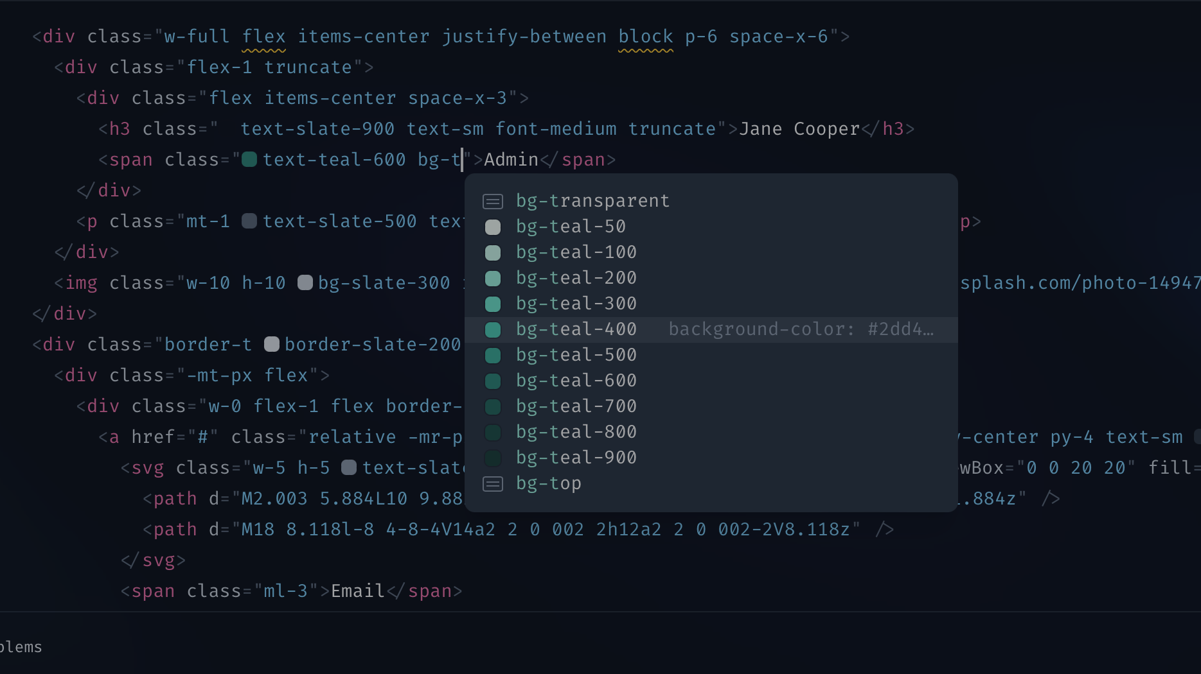
Integrate well with your IDE choice

Slide 10
DATABASE

Slide 11

DATABASE :
Documented Oriented Database
Basic Hierarchy :
Clusters
Databases
Collections
Documents / Objects
Data/Documents

Slide 12
DATABASE
ISSUE : We set up class architecture for all the classes we were going to need beforehand. Some properties in some objects were instances of objects. Nested Documents in MongoDB were too large and took too long to query

Slide 13
DATABASE
ISSUE : Since fronted uses JavaScript , we can’t force types like with Typescript , tedious to do validation on frontend

Slide 14

DATABASE
SOLUTIONS : USE ORMs ( Technically an ODM )!
Enforce schema at the application level

Slide 15
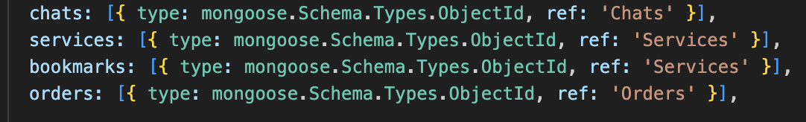
DATABASE
SOLUTION :
Using mongoose ,we were able to store references instead of the objects themselves. Since MongoDB indexes on id by default, we are able to access those documents in much faster time
UserModel.js

Slide 16
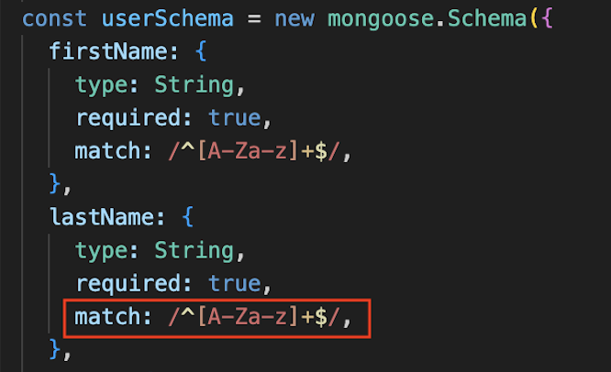
DATABASES
SOLUTION :
Using Mongoose , we are able to define strict constraints for our datatypes, we can even match regex and formats of string, so our calls give us errors for invalid data
UserModel.js

Slide 17
USE ORMS !

Slide 18
TESTING

Slide 19
TESTING ( UNIT) :
( So far ) We have implemented Unit tests for the backend

Slide 20
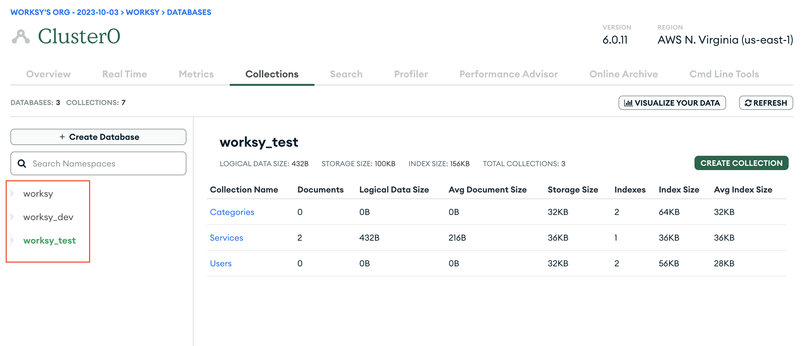
TESTING ( UNIT) :
Set up an instance of a test database in our MonogDB Cluster

Slide 21
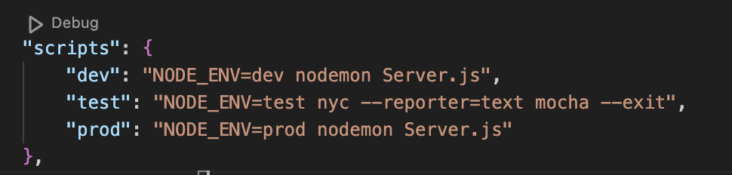
TESTING ( UNIT) :
Using package.json, environment files and variables we specify our test database at runtime

Slide 22
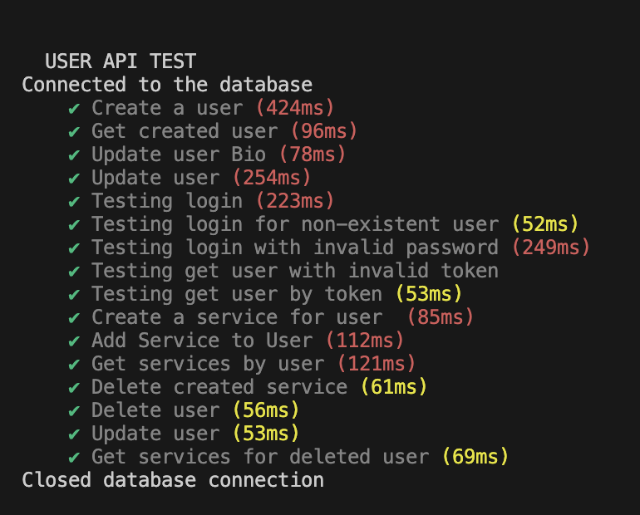
TESTING ( UNIT) :
Unit Tests , tests follow a logical order so we know where to add and remove tests if we need to

Slide 23

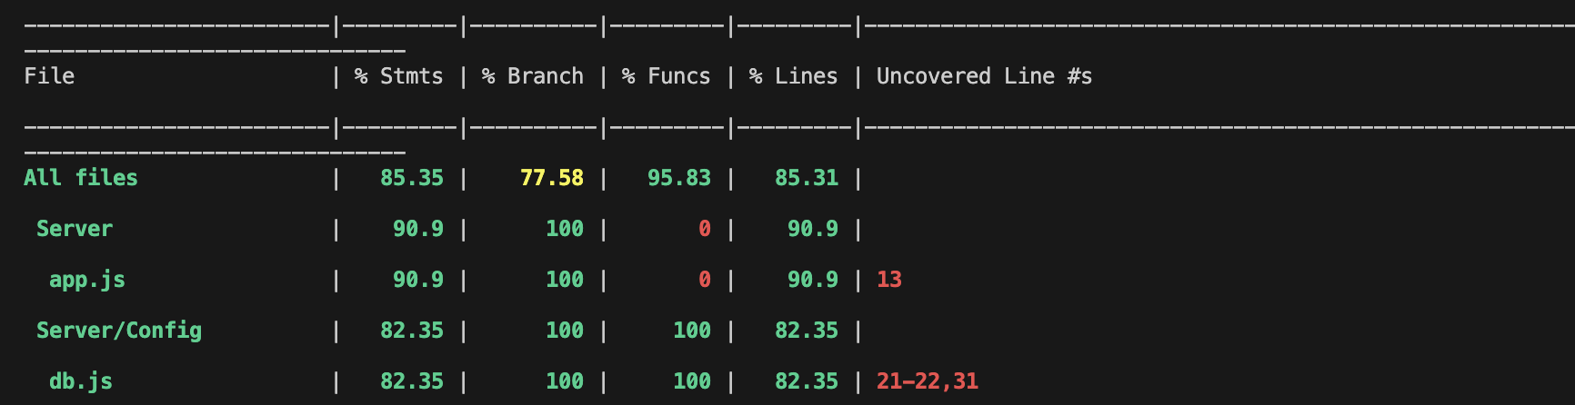

TESTING ( UNIT) :
Test Reporting : Use mocha , nyc/instalbul to define test dependencies, report speed for tests ( and API calls ) and code coverage in our server Directory as well

Slide 24
C.I

Slide 25
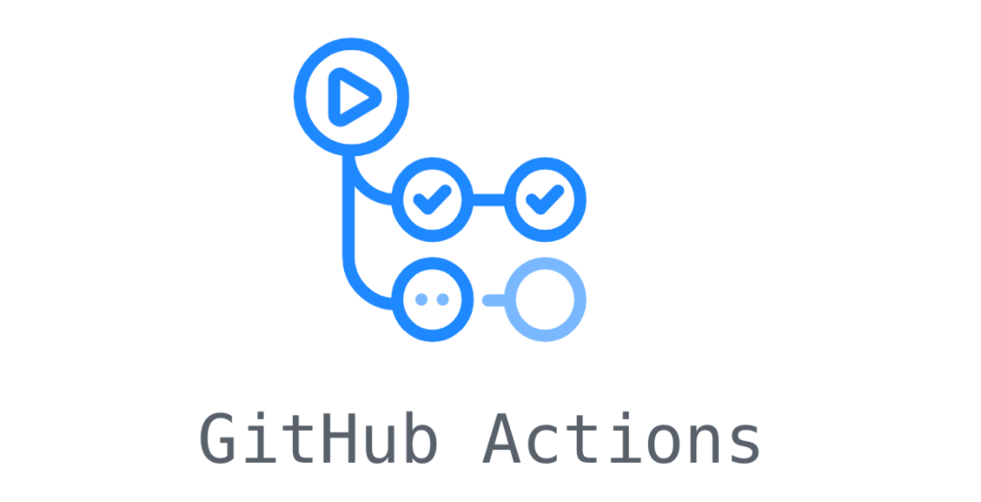
CI :
Github actions with yaml files

Slide 26
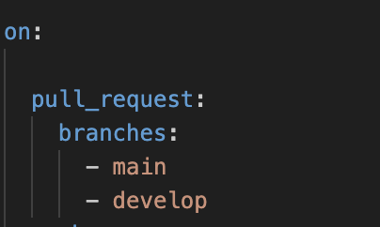
CI :
Triggered on pull request into main branch

Slide 27
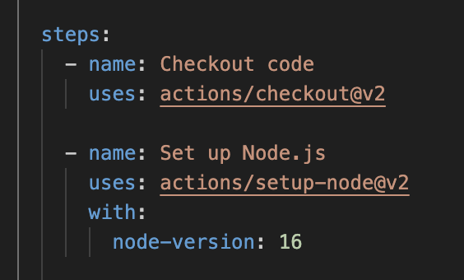
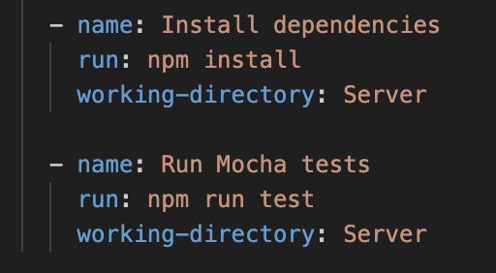
CI :
Sets up node environment
Installs dependencies and runs tests

Slide 28
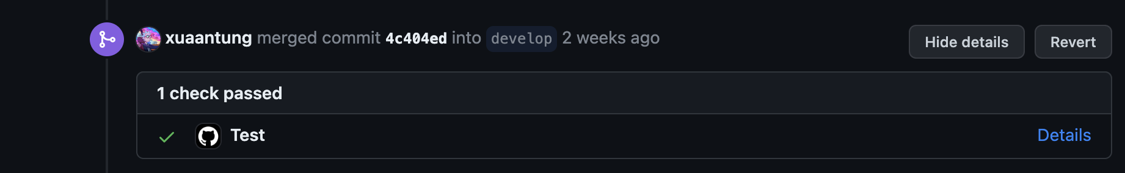
CI :
In Github – Checks require all tests to pass before code review and finally merging into branch

Slide 29
WORKFLOW

Slide 30
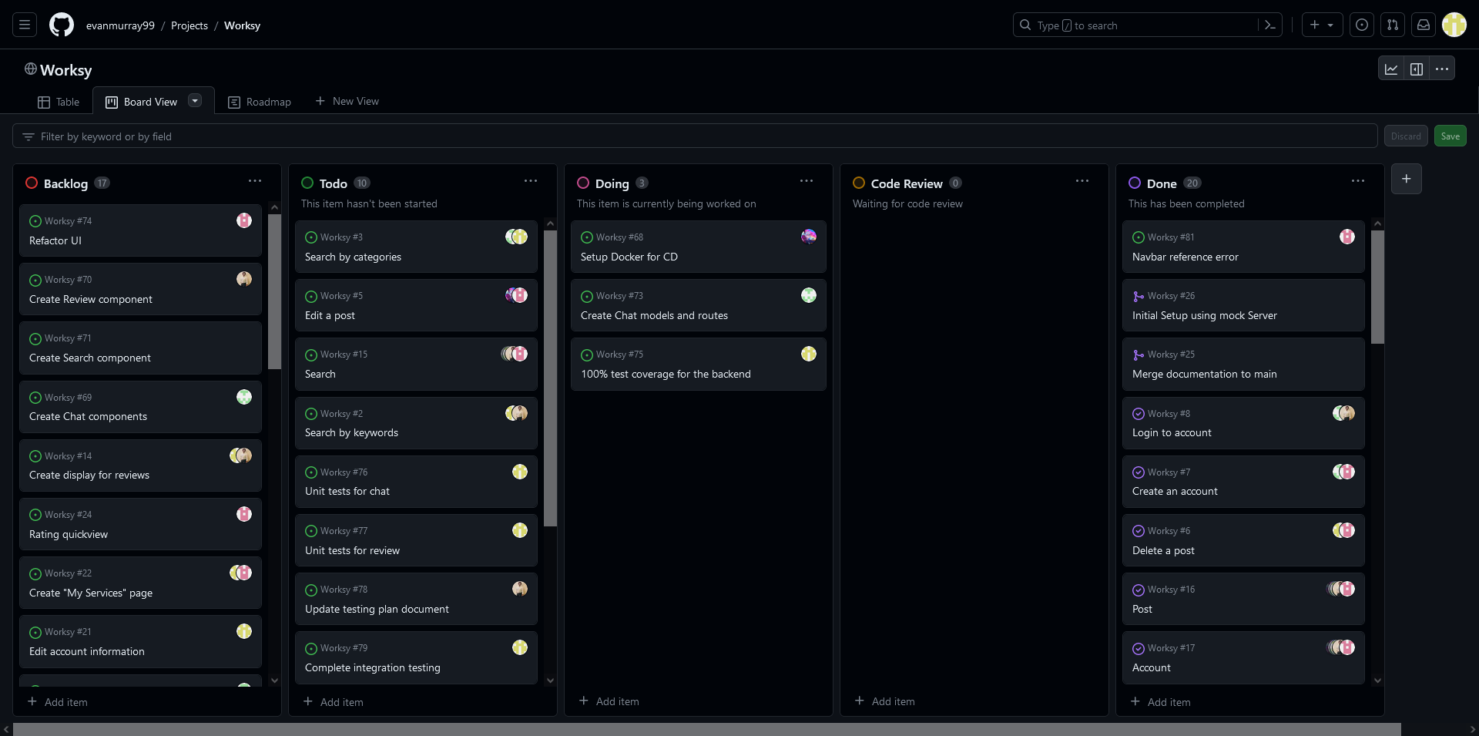
GitHub Projects

Slide 31
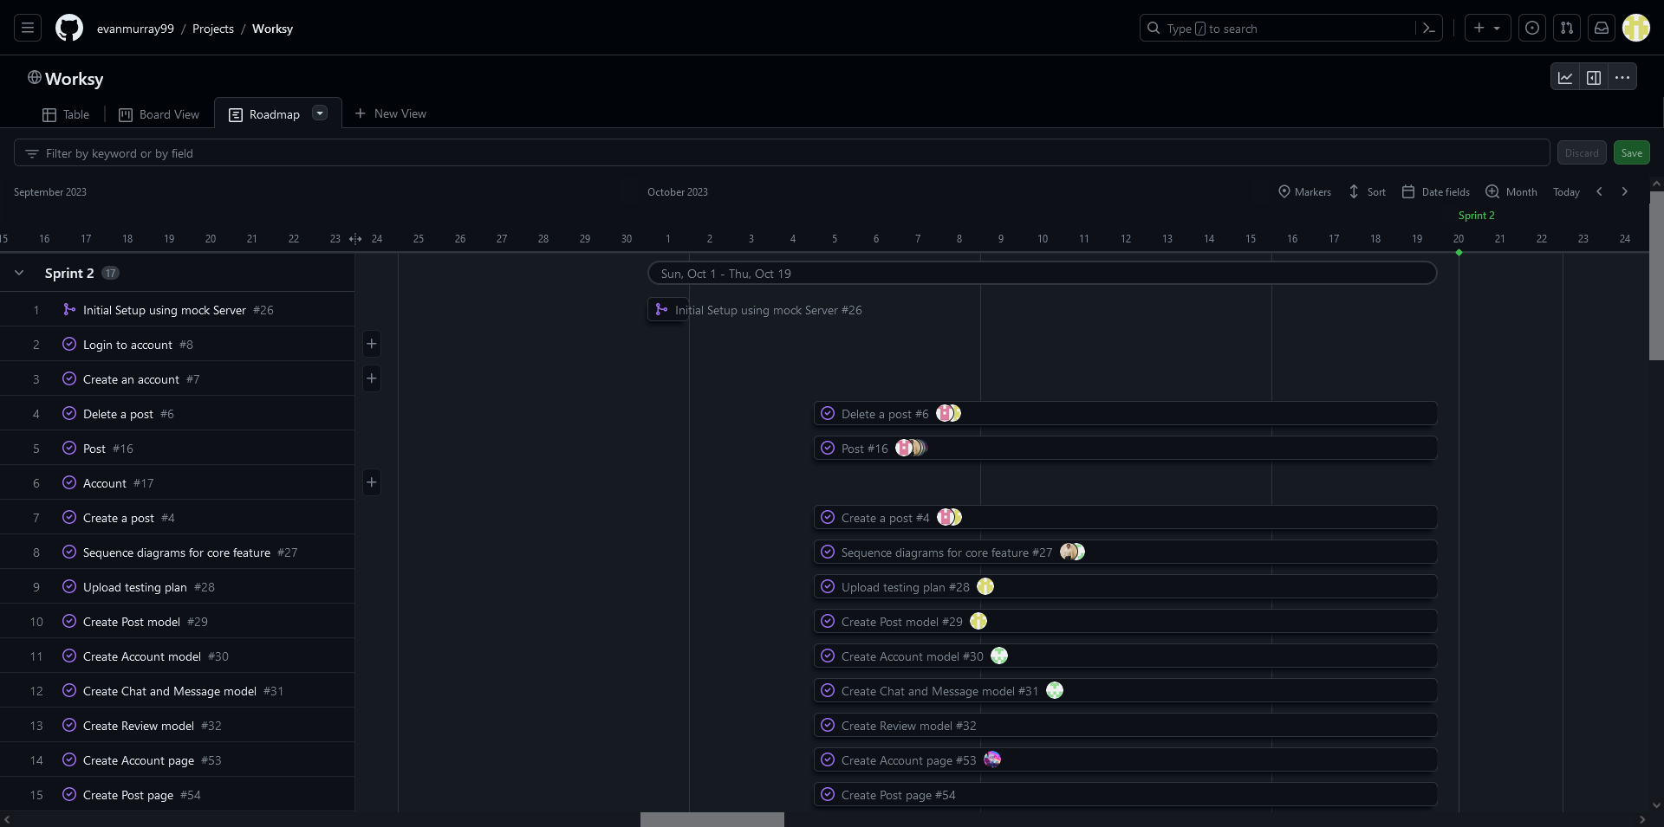
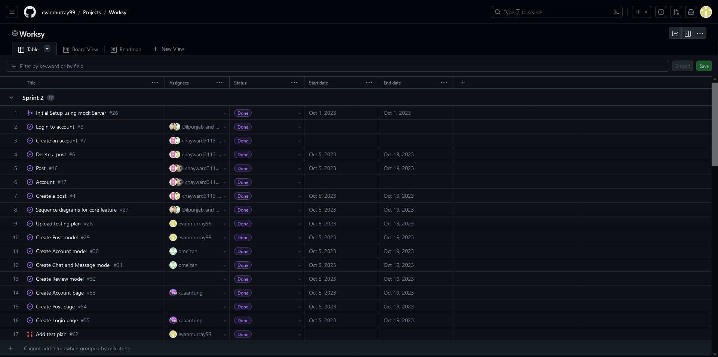
What is GitHub Projects?
A project is an adaptable spreadsheet, task-board, and road map that integrates with your issues and pull requests on GitHub to help you plan and track your work effectively.

Slide 32
Why use GitHub Projects?
Rather than enforcing a specific methodology to project management, a project provides flexible features you can customize to your team’s needs and processes.
Your projects are built from the issues and pull requests you add, creating direct references between your project and your work. Information is synced automatically to your project as you make changes, updating your views and charts.
You can use custom fields to add metadata to your issues, pull requests, and draft issues and build a richer view of item attributes. You’re not limited to the built-in metadata (assignee, milestone, labels, etc.) that currently exists for issues and pull requests.

Slide 33
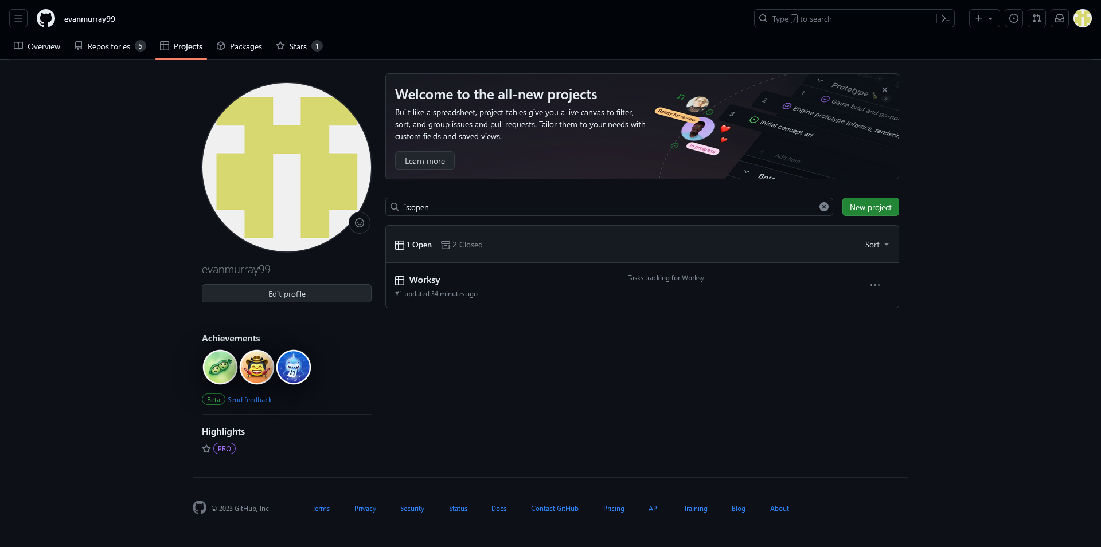


How to use GitHub Projects (step 1)
Create a new project from your GitHub profile and add status tags to your project.

Slide 34
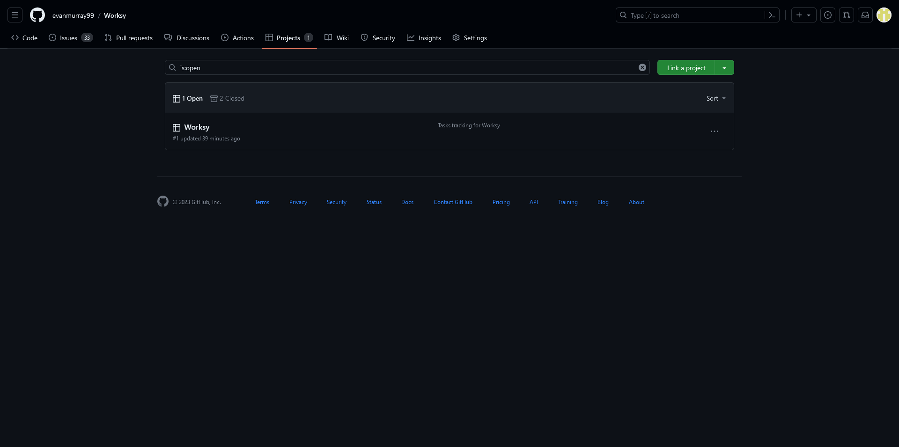
How to use GitHub Projects (step 2)
Link project to GitHub repo

Slide 35
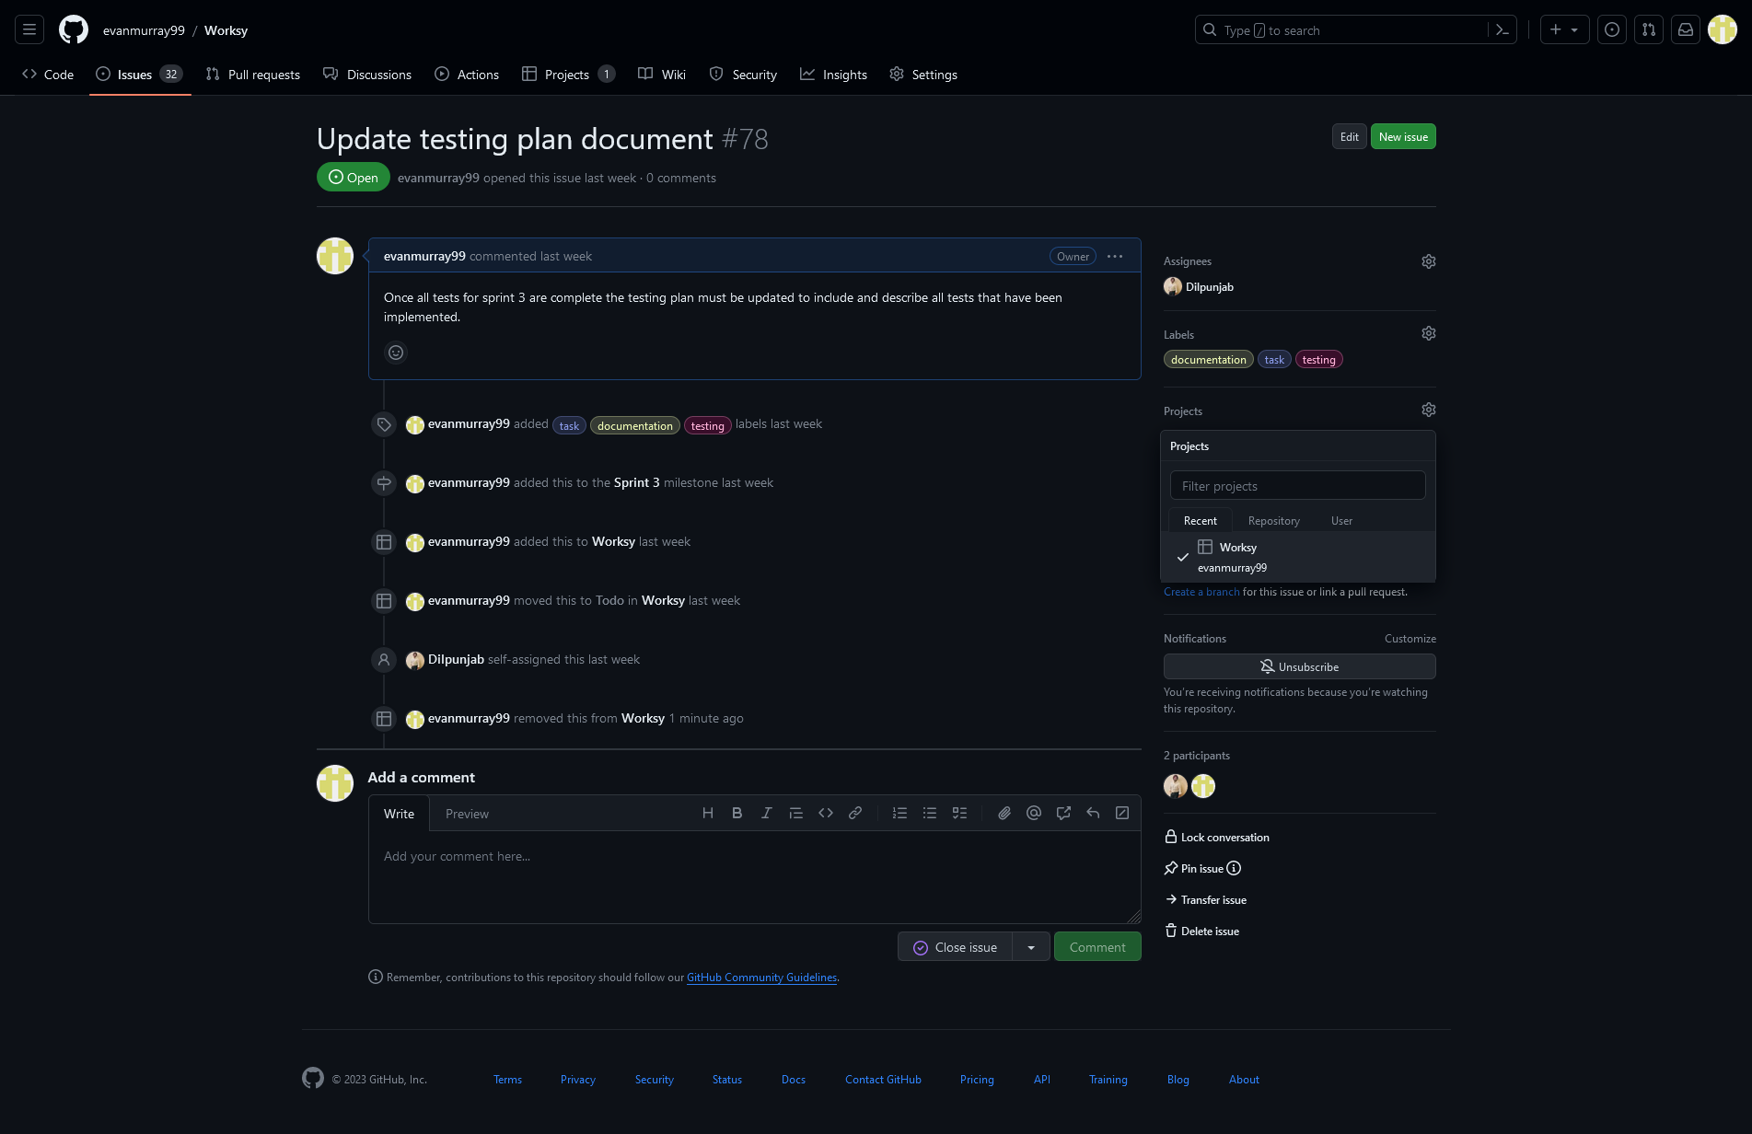
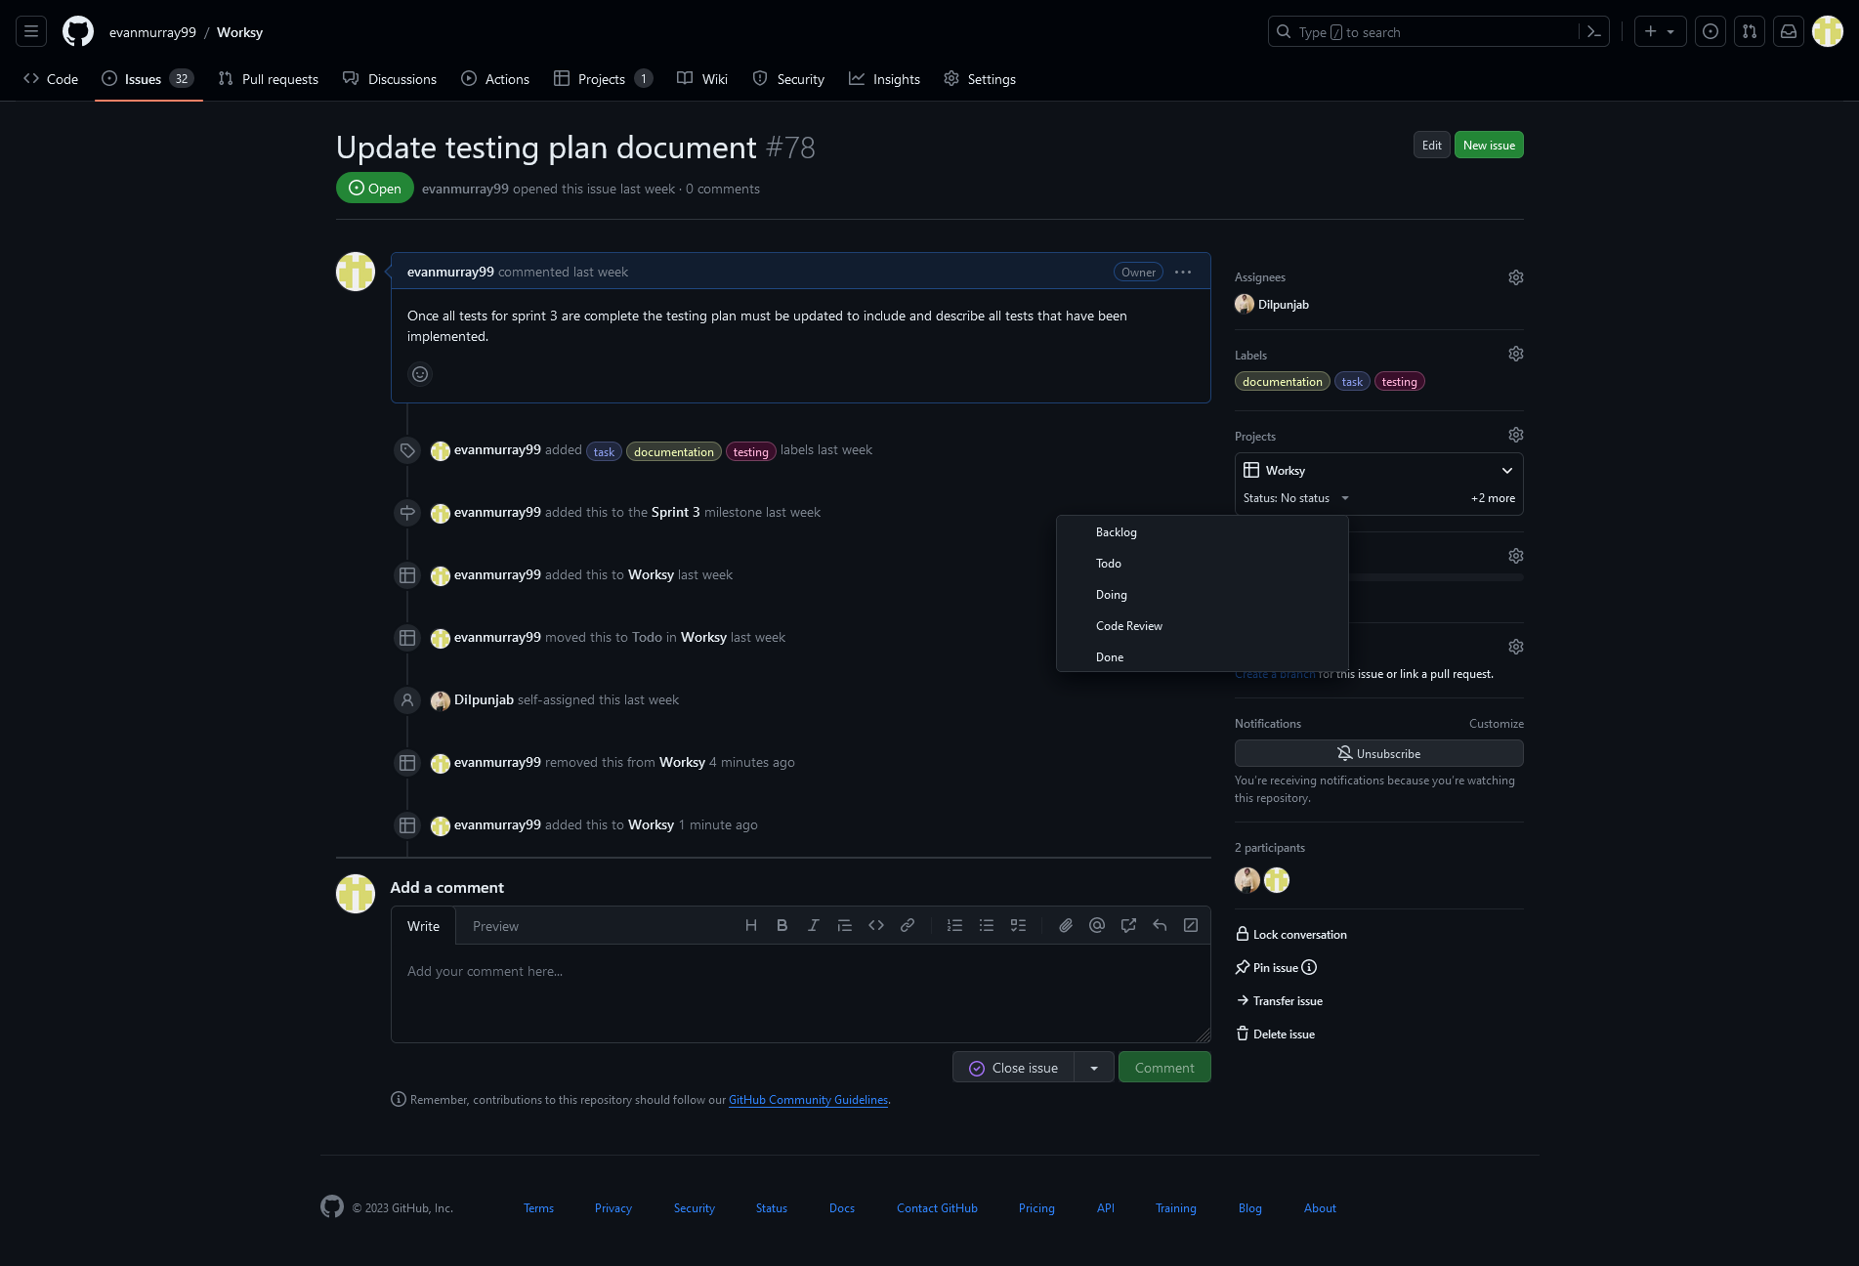


How to use GitHub Projects (step 3)
Once issue has been created add it to your project
Select issue status
Don’t forget to select a milestone for the issue!

Slide 36
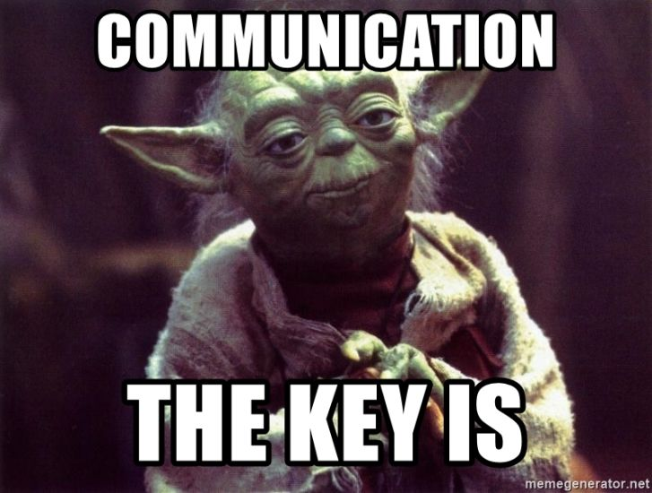
GitHub Projects
It really is as easy as 1-2-3.
Helps communication between group members and tracking what your peers are working on.
After initial project is setup all it takes is a couple dropdown menu clicks to add items to your project overview, so why not use it!

Slide 37
Challenges and Solutions

Slide 38
Challenge 1: Communication
We had issues where the code for the backend didn't meet the frontend expectations.
At times we also weren't aware of what our teammates were doing leading to repeated work.
Solution: Is to discuss any changes to our plans as well as to have meetings twice a week.

Slide 39
Challenge 2: Merge Conflicts
In Sprint 2 we ran into many merge conflicts because our tasks were too big resulting in changes to the same files. Additionally, since tasks were too big our pulls were few and far between further increasing the risk of merge conflicts.
Solution: Our solution is to break our project into smaller pieces so that we are doing more frequent pulls.

Slide 40
Challenge 3: Code Review
Some of the pull requests were not reviewed or were self-merged.
Pull requests often remained unchecked for multiple days.
Solution: Is to assign someone to review pull requests and code should be reviewed by the end of the following day.

Slide 41

QUESTIONS

